Slide 1
Short-term Solar Radiation Prediction in Huddersfield Based on the Feedforward Neural Network
Presenter: Zuolu Wang
Email: Zuolu.Wang@hud.ac.uk
Centre for Efficiency and Performance Engineering (CEPE)
University of Huddersfield, UK
14 June 2021

Slide 2
Outline
Introduction
Methodology
Feature extraction
Results and discussion
Conclusion

Slide 3
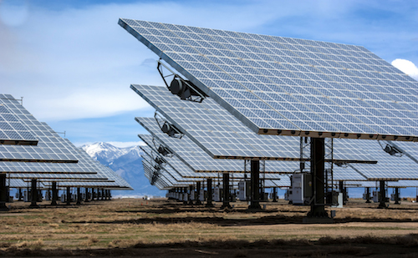
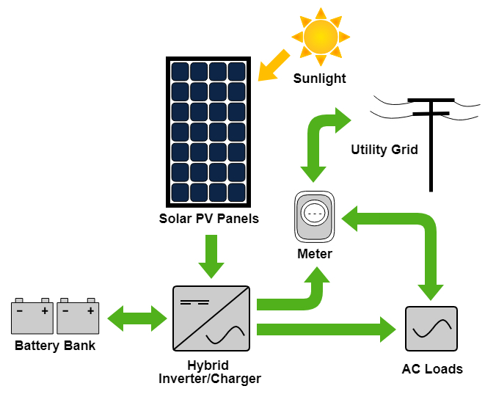
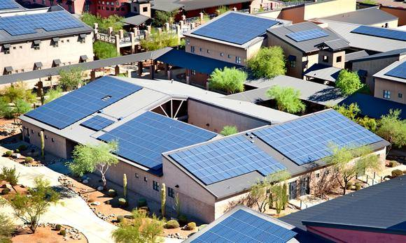
Introduction
Many photovoltaic systems have been widely increased to make full use of the power source of sustainable solar energy to produce electricity.
Solar radiation (SR) prediction plays an important role in making power dispatch schemes.

Slide 4
Introduction
Based on different types of meteorological variables, a variety of prediction methods have been proposed for SR prediction in different regions.
Author | Time scale | Method | Feature | Region
Junho Lee et al. | Hourly | Ensemble learning model | Ten weather variables (e.g., hour, sky cover, temperature) | US
A. Khosravi et al. | Hourly | Multilayer feed-forward neural network | Local time, temperature, pressure, wind speed, and relative humidity | Abu Musa Island
Qing et al. | Hourly | Long short-term memory | Hour, day, month and six weather variables (e.g., temperature, and visibility | Island of Santiago
Yong Zhou et al. | Daily and monthly | Multi-task learning and Gaussian process regression model | Average temperature, temperature diurnal, relative humidity and sunshine rate | China

Slide 5
Introduction
Solar radiation prediction:
Short-term prediction
Feature selection
In this work, we conduct the hourly SR prediction of the Huddersfield area (UK) based on the dataset obtained from MET Office, UK.
The sensitivity analysis of each weather feature is carried out to select the suitable variable combinations and improve the prediction accuracy.

Slide 6
Methodology
Feedforward neural network (FNN)
FNN is used for SR prediction due to its high reliability and lower computational complexity.
$y\left(x\right)=L\left(\sum_{i=1}^{n}{w_{i}\left(t\right)∙}x_{i}\left(t\right)+b\right) (1)$
$y\left(x\right)$: the output of SR, $L$: the hidden transfer function, $n$: the number of the hidden neuron, $w_{i}\left(t\right)$: weights $x_{i}\left(t\right)$: input variable, $b$: neuronal bias
Feature sensitivity analysis based on FNN
Seasonal feature
Suitable input combinations
FNN model training
Test

Slide 7
Methodology
Evaluation metrics
To quantify the prediction performance of the established model, two benchmarks including R² and mean absolute percentage error (MAPE) are utilized in evaluation to the accuracy of the prediction models.
$R^{2}=1−\frac{\sum_{i=1}^{n}{{(y_{i}−x_{i})}^{2}}}{\sum_{i=1}^{n}{{(x_{i}−{\overline{x}}_{i})}^{2}}}$ (2)
$MAPE=\frac{1}{n}\sum_{i=1}^{n}{\left|\frac{x_{i}−y_{i}}{x_{i}}\right|×100\%}$ (3)
$n$: the number of observation data
$x_{i}$: the measured data
$y_{i}$: the predicted data
${\overline{x}}_{i}$: the mean of the measured data

Slide 8
Feature selection
Dataset
The hourly weather data used in this study is supported by the MET office and the data is collected from the weather station close to Huddersfield in the UK. The historical observation data range from May to September in 2018.
Meteorological data: solar radiation, hour, temperature, humidity, wind direction, windspeed, gust, pressure, and cloud cover.
Training data: hourly data from May to September in 2018.
Testing data: the data of the first day of each month.

Slide 9
Feature selection
Contribution analysis of Meteorological features using FNN
Input Variables | R² (%)
 | 1st May. | 1st Jun. | 1st Jul. | 1st Aug. | 1st Sep. | Average
Hour | 85.55 | 86.03 | 97.46 | 78.04 | 90.69 | 87.55
Humidity | 35.10 | 52.86 | 19.01 | 24.42 | 63.39 | 38.956
Temperature | 26.27 | 36.52 | 39.81 | 18.55 | 20.15 | 28.26
Windspeed | 5.00 | 31.12 | 7.03 | 22.23 | 38.11 | 20.698
Gust | 4.00 | 23.20 | 0.80 | 0.50 | 51.17 | 15.934
Wind direction | 6.01 | 27.71 | 14.7 | 0.02 | 15.78 | 12.844
Pressure | 0.98 | 2.08 | 36.32 | 38.07 | 0.89 | 15.668
Cloud cover | 19.41 | 0.02 | 0.01 | 7.50 | 0.25 | 5.438
Hour + Humidity + Temperature

Slide 10
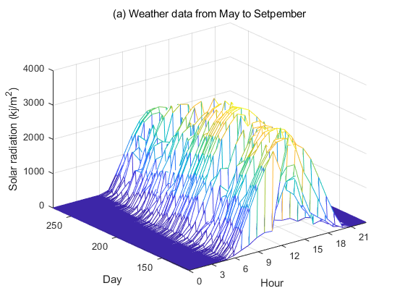
Feature selection
Seasonal feature - Month
Figure 1. The hourly solar radiation from May to September.
Input variables: hour, humidity, temperature, and month

Slide 11
Results and discussion
Comparison of the different input variables based on the FNN model
Input Variables | R² / MAPE (%)
 | 1st May. | 1st Jun. | 1st Jul. | 1st Aug. | 1st Sep.
Hour | 85.55/ 1.46 | 86.03/ 1.40 | 97.46/ 2.63 | 78.04/ 1.00 | 90.69/ 1.11
Hour + Month | 91.00/ 0.44 | 86.14/ 0.40 | 97.52/ 2.00 | 84.32/ 0.70 | 93.69/ 2.60
Hour + Month + Humidity | 91.89/ 0.52 | 87.81/ 0.70 | 93.18/ 0.90 | 84.85/ 1.00 | 94.16/ 0.71
Hour + Month + Humidity + Temperature | 95.35/ 0.30 | 88.65/ 0.31 | 93.16/ 0.78 | 85.63/ 0.80 | 94.45/ 0.10

Slide 12
Results and discussion
Test results obtained by FNN and the least square support vector regression (LSSVR)

Slide 13
Results and discussion
Performance evaluation of the LSSVR and FNN model
Model | $R^{2}/MAPE$ (%)
 | 1st May. | 1st Jun. | 1st Jul. | 1st Aug. | 1st Sep.
LSSVR | 82.08/ 0.32 | 83.53/ 0.59 | 89.51/ 0.63 | 82.74/ 0.87 | 87.70/ 0.44
FNN | 95.35/ 0.30 | 88.65/ 0.31 | 93.16/ 0.78 | 85.63/ 0.80 | 94.45/ 0.10

Slide 14
Conclusion
FNN is an effective tool for nonlinear analysis so that it can be used for input variables selection.
The contribution analysis of individual input variables helps to determine important input features to improve the accuracy of solar radiation prediction.
FNN model provides a more reliable short-term solar radiation prediction of Huddersfield than the LSSVR model.

Slide 15
Thanks for your attention

