Slide 1
Practical use of diagnostic signs of vibration invariant to machinery construction
Seventeenth International Conference
on Condition Monitoring and Asset Management CM2021
Virtual 14 – 18 June 2021
Alexey V. Kostyukov, PhD Sergey N. Boychenko, PhD
Notes:
Good afternoon dear colleagues!
My name is Sergey Boychenko
I represent Russian company DYNAMICS.
The main product of the company is the COMPACS system, that generates automatic prescriptions in real-time predictive analytics by build-in Artificial Intelligence.
I would like to present you my report on the topic:

Slide 2
The most efficient way to reduce the operational costs is to apply a modern technology of resource-saving operation of machinery based on stationary real-time condition monitoring systems.
One of important quality of diagnostic systems as invariance to construction and operational procedure.
RMS of vibration signal (acceleration, velocity and displacement) is one of invariance diagnostic features.
2
www.dynamics.ru
Notes:
Production today is impossible to imagine without systems for machinery condition monitoring. Constant increasing level of production automation results in higher number of operating machines and facilities, which, consequently, increases the cost for their maintenance and risk of accidents due to failure. The most efficient way to reduce the operational costs is to apply a modern technology of resource-saving operation of machinery based on stationary real-time condition monitoring systems.
One of important quality of diagnostic systems is invariance to construction and operational procedure.
To implement this principle, the system has a special vector of diagnostic signs invariant to construction and operational procedure of the monitored equipment.
This report shows practical application of such a diagnostic sign – RMS of vibration signal (acceleration, velocity and displacement)

Slide 3
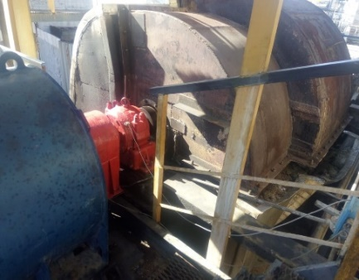
Electric motor
at a Crude Distillation Unit
3
www.dynamics.ru
Notes:
Let’s consider an example of timely maintenance of an electric motor at a Crude Distillation Unit (Figure on slide) based on the diagnostic system’s real-time recommendations.

Slide 4
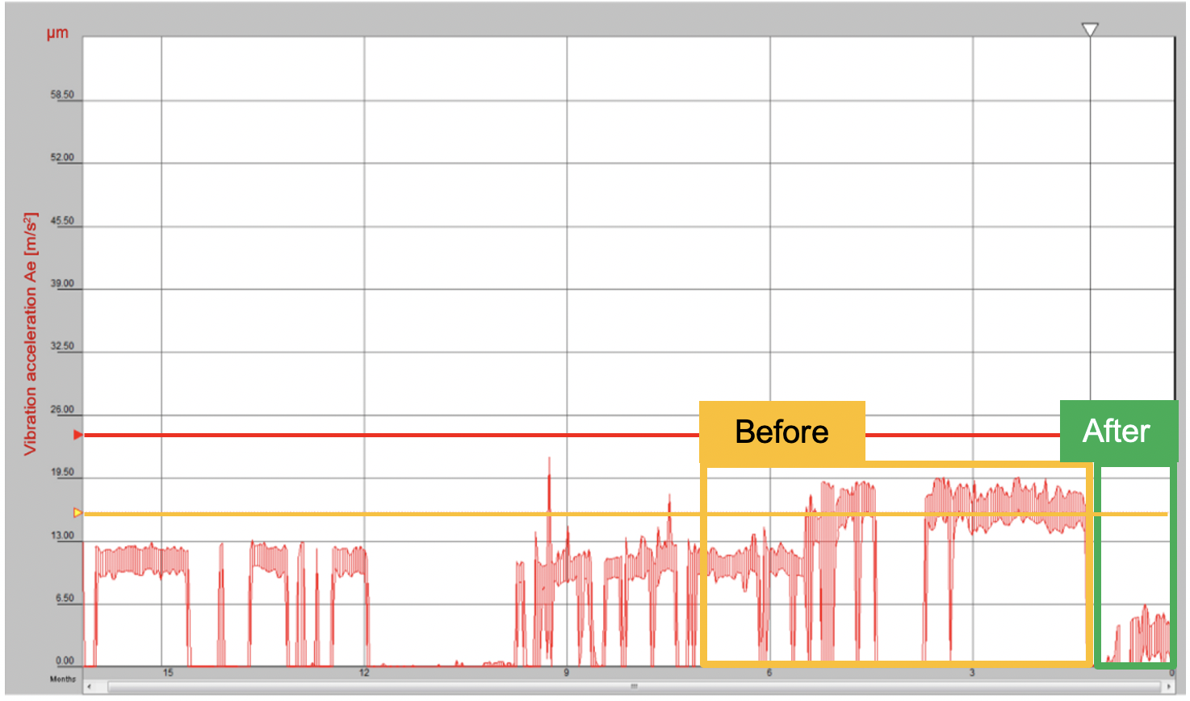
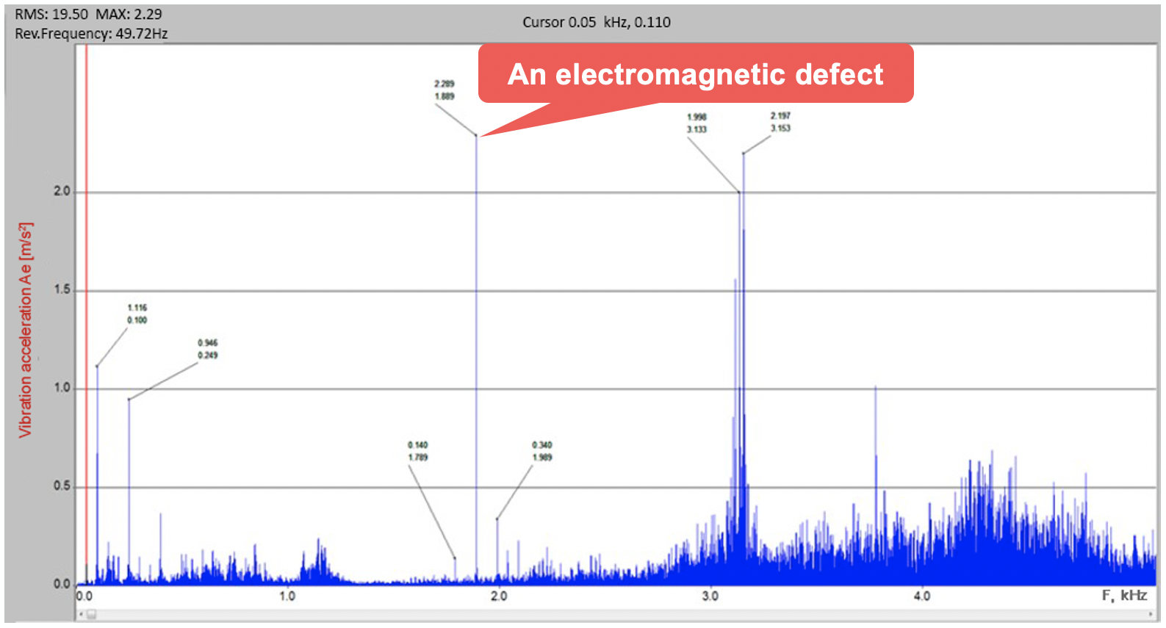
A 1-year trend of invariant diagnostic signs – RMS of vibration acceleration
Direct spectrum of the acceleration
4
www.dynamics.ru
Notes:
This slide shows a 1-year trend of invariant diagnostic signs – RMS of vibration acceleration measured on the front bearing of the pump motor. We can see a slow acceleration trend in the yellow section labelled “Before”. After three months the motor reached the Action Required condition, while the system diagnosed an electromagnetic defect and prescribed corrective actions by displaying a message with yellow background showing “Electromagnetic vibration source check electric motor”. The electromagnetic defect caused an increased load and premature wear of the motor bearings. When the motor was in the Action Required condition, the system diagnosed a group of its front bearing faults (outer and inner races, cage, rolling elements).
In the direct spectrum of the acceleration from an accelerometer mounted on the front bearing of the motor, the spectral components typical for an electromagnetic defect were prevalent. The second harmonic of power supply (100 Hz), the slot harmonic (38 slots) and its side components.
The Unit staff planned maintenance in advance and maintained the electric motor using the system recommendations. They also discovered and eliminated a “soft foot”, thereby conducting in-place condition-based maintenance and extended the lifespan of the machine.

Slide 5
Air blower
at a Crude Distillation Unit
5
www.dynamics.ru
Notes:
Another example shows the process of eliminating the root cause of air blower failures of a Crude Distillation Unit

Slide 6
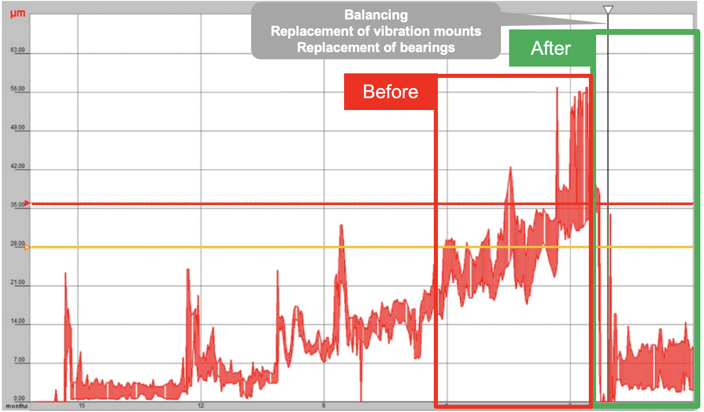
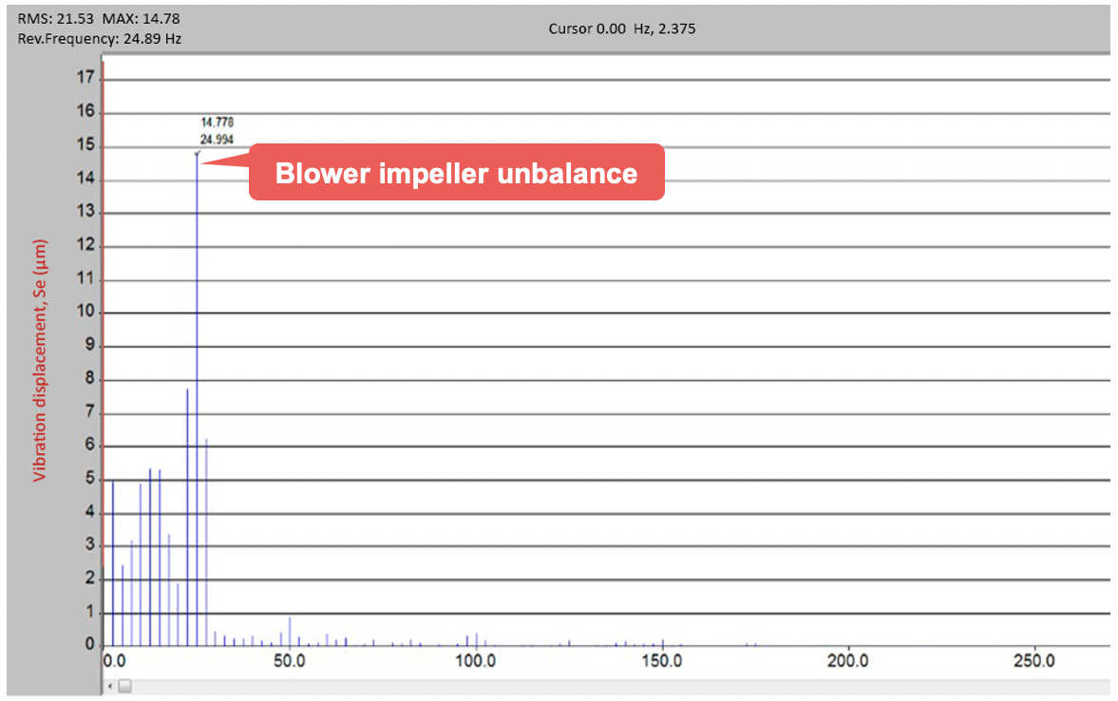
Displacement trend of the air blower
Spectrum of the displacement signal
6
www.dynamics.ru
Notes:
On this slide we can see a slow growth in the displacement trend on the air blower from an Acceptable to Unacceptable state. The diagnostic system automatically generated recommendations “Check looseness” and “Check imbalance”.
Right figure shows that in the spectrum of the displacement signal from the rear bearing, there was only a first rotor harmonic (24.9 Hz). This signal is typical for blower impeller imbalance. Similar signals were measured on all bearings of the air blower and electric motor.
The investigation revealed that the root cause of the blower failure was deterioration or wear of the vibration mounts which typically appears as imbalance. After the maintenance and replacement of the vibration mounts were done, and dynamic balancing of the impeller was completed, the air blower health improved and became acceptable. As a result, the blower vibration decreased by three times.

Slide 7
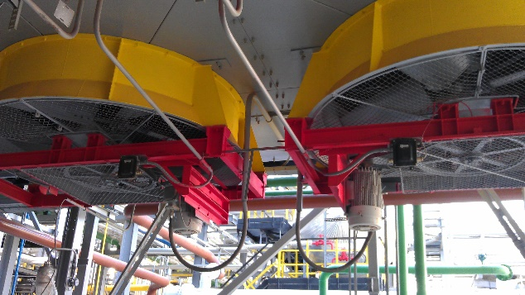
Fin fan at Isomerization Unit
7
www.dynamics.ru
Notes:
Let’s consider an example of reducing the increased destructive forces on a fin fan at Isomerization Unit.

Slide 8
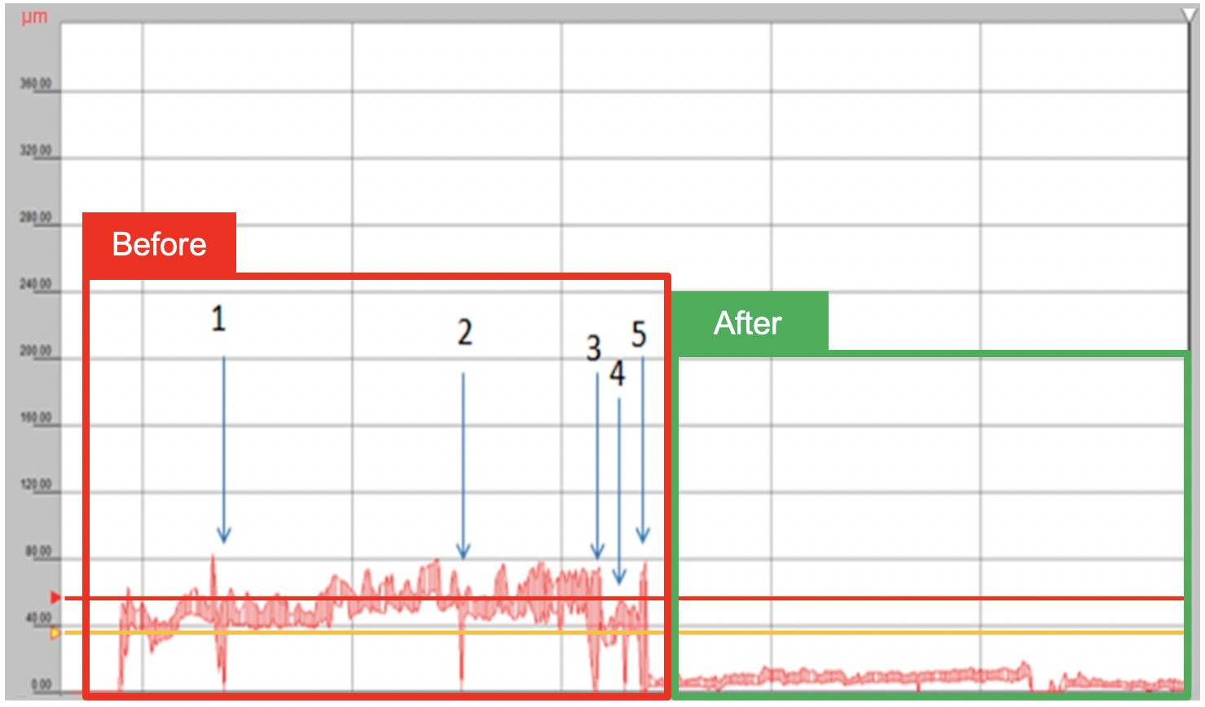
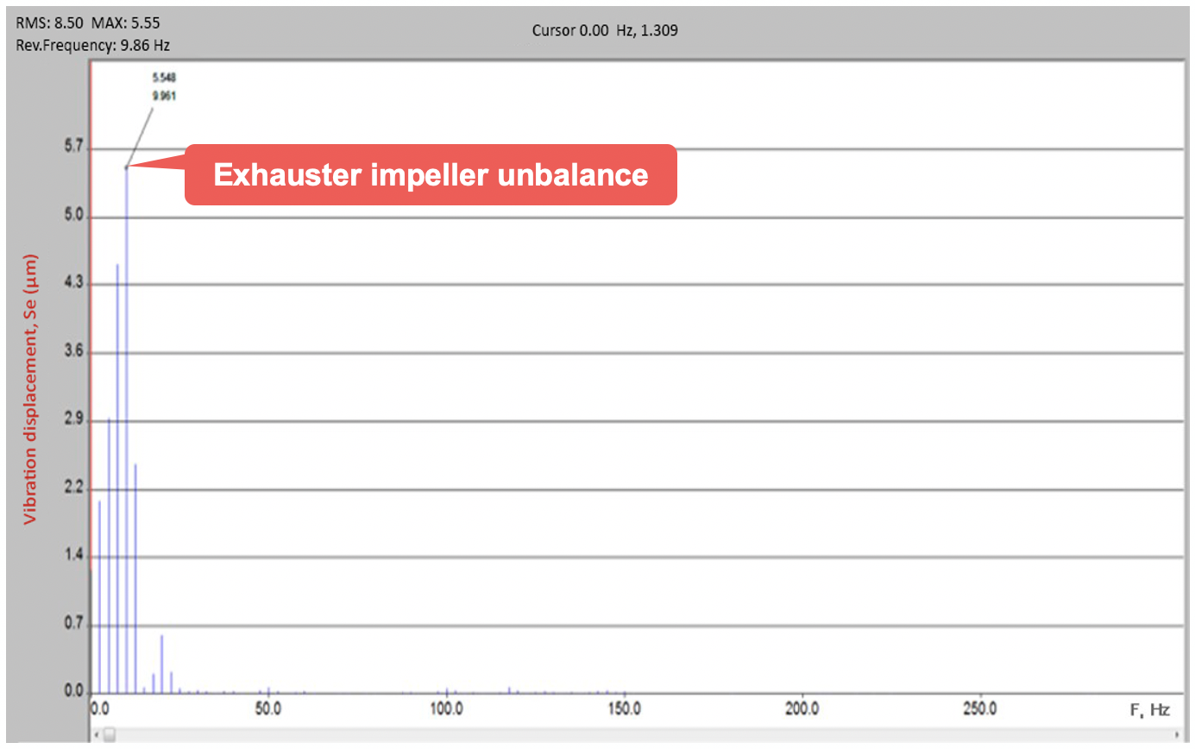
Displacement trend of the air blower
Spectrum of the displacement signal
8
www.dynamics.ru
Notes:
The fin fan operated in the Action Required and Unacceptable conditions, and the Unit maintenance team was carrying out its repairs at points 1, 2, 3, 4, and 5 using the recommendation “Check Looseness”. The repair included tightening bolts on the supporting structure. As we can see, the repairs did not yield the desired result and after a while the machine condition became Unacceptable.
In the spectrum of the vibration displacement signal from the motor’s front bearing there were mainly harmonics in the frequency range from 5 to 12 Hz. This low-frequency signal is typical for loose fastening of air cooler elements. At point 6, the maintenance team improved the stiffness of the supporting structure holding a group of fans, and the machine vibration reduced by 8 times. The destructive forces came from the loose fastening to the supporting structure

Slide 9
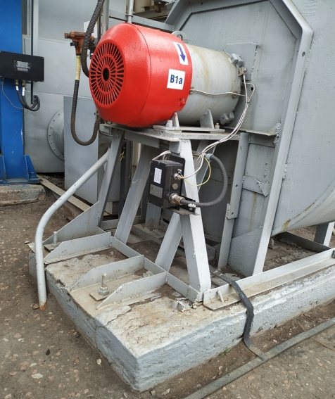
Fan on Bitumen Unit
9
www.dynamics.ru
Notes:
The next example shows a case on determining root causes of poor fastening or looseness of fan on Bitumen Unit
The fan is a low-pressure single-inlet centrifugal fan that operates at 980 RPM, and its impeller with 12 blades is mounted on the motor shaft. Atmospheric air is pulled in, and a gate valve restricts the flow to the Bitumen vessel. The main purpose of the fan is to cool down the vessel. The diagnostic system’s vibration sensor is installed on the front motor bearing. The system issued a warning to the personnel that the fan was in an Unacceptable condition and showed a recommendation “CHECK FASTENING.

Slide 10
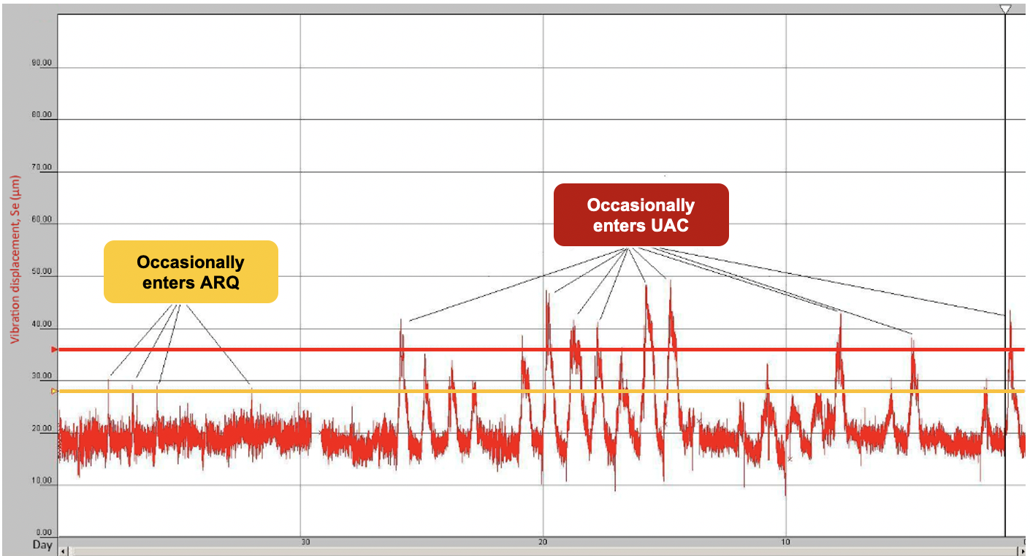
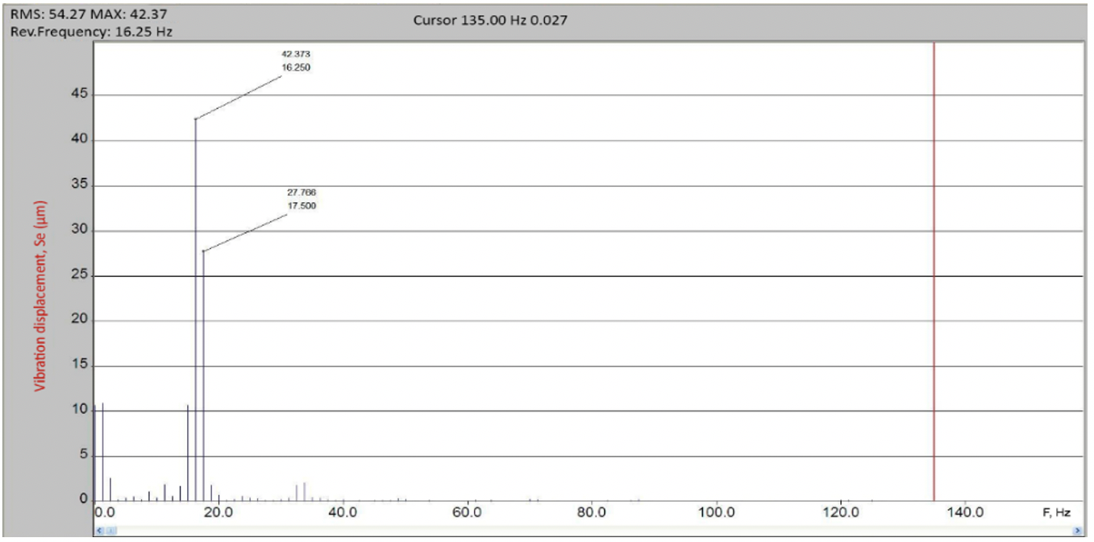
40-day vibration displacement trend
Spectrum of the displacement signal
10
www.dynamics.ru
Notes:
The 40-day vibration displacement trend in left figure shows that the fan condition occasionally reached ACTION REQUIRED or UNACCEPTABLE condition. The spectrum of vibration displacement signal (right figure) from the front motor bearing shows a harmonic component at the rotation frequency which takes 80% of the whole RMS signal. This indicates the machinery fastening is poor.
Examination of the fan revealed poor fastening between the frame and the base due to cracks and crumbling of the foundation. When the gate valve is open, the load to the foundation increases and, consequently, vibration displacement grows; we can see exactly that on the 40-day vibration displacement trend in left figure.
As a result, we recommended that our customer repair the foundation, improve the frame’s fastening, and as always dynamically balance the impeller.

Slide 11
Conclusion
The examples considered illustrate practical application of invariant vibration signs used for diagnostics of machinery equipment of production plants. Recommendations for the personnel issued by the AI System are used to bring the machinery to a normal condition
11
www.dynamics.ru

Slide 12
Thank You For Your Attention!
12
www.dynamics.ru

